Slide 1
BUSI 650 Introduction to Machine Learning: Clustering
[2] Essentials of Marketing Analytics 1st Edition, By Joseph Hair and Dana E. Harrison and Haya Ajjan. Mc Graw-Hill (2022). ISBN10: 1264263600 | ISBN13: 9781264263608

Slide 2
What Is Cluster Analysis?
A market is a group of people who gather to buy and sell.
Within each market, there are subgroups with different needs.
Market segmentation lets companies divide consumer and business markets into smaller groups with shared characteristics.
Segmenting a market using shared characteristics is referred to as cluster analysis.
Cluster analysis uses algorithms to explore data relationships, then develops smaller groups from larger populations.
Marketers use these insights to:
Improve marketing strategies.
Better allocate resources.
Gauge new product development.
Select the most receptive test markets.
[2] Essentials of Marketing Analytics 1st Edition, By Joseph Hair and Dana E. Harrison and Haya Ajjan. Mc Graw-Hill (2022). ISBN10: 1264263600 | ISBN13: 9781264263608

Slide 3
How Is Cluster Analysis Used in Practice?
Clustering algorithms identify groups with similar traits.
American Express segmented their market into loyal customers, tailored products for them, and increased their market share.
Auto companies use segmentation to target specific consumers.
Best Buy segmented loyal customers into five segments and focused on them to gain a 10 percent growth in sales.
Clustering enables marketers to identify hidden patterns and structures.
Clustering provides the clusters, the companies provide the meaning.
Companies typically assign names and definitions to each cluster.
Distinguishing clusters from the larger population is necessary for understanding and responding to engagement and buying behaviors
[2] Essentials of Marketing Analytics 1st Edition, By Joseph Hair and Dana E. Harrison and Haya Ajjan. Mc Graw-Hill (2022). ISBN10: 1264263600 | ISBN13: 9781264263608

Slide 4
How Does a Cluster Analysis Function?
Cluster analysis organizes data into two or more similar groups which exhibit the following characteristics.
Within cluster (intra-cluster) homogeneity or similarities.
Dissimilar characteristics (heterogeneity) between groups (inter-cluster).
Similarities between groups is calculated using various measures of the distance between groups.
Smaller distances represent greater similarity.
No established dependent variable is specified with cluster analysis.
So the technique is considered an unsupervised learning.
The goal of cluster analysis is to model the underlying structure and distribution of characteristics in the data to separate a dataset into homogenous subgroups.
[2] Essentials of Marketing Analytics 1st Edition, By Joseph Hair and Dana E. Harrison and Haya Ajjan. Mc Graw-Hill (2022). ISBN10: 1264263600 | ISBN13: 9781264263608

Slide 5
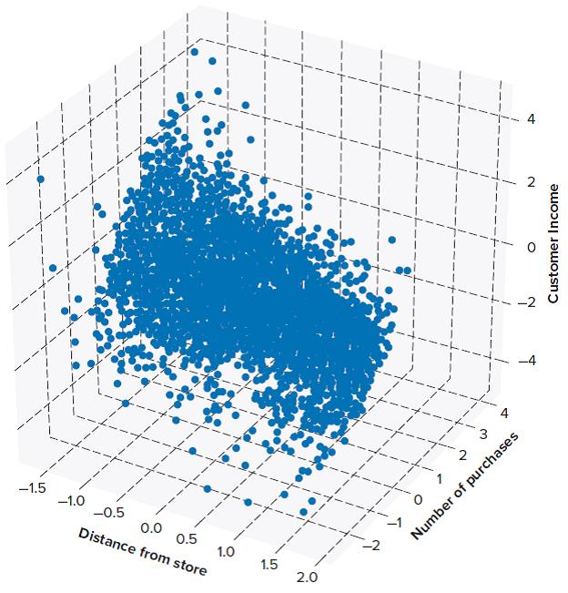
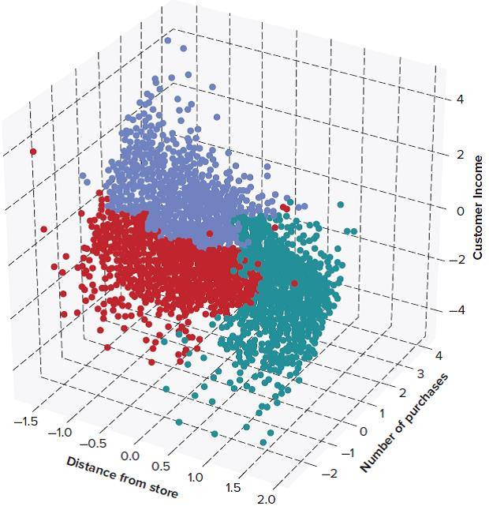
[2] Essentials of Marketing Analytics 1st Edition, By Joseph Hair and Dana E. Harrison and Haya Ajjan. Mc Graw-Hill (2022). ISBN10: 1264263600 | ISBN13: 9781264263608
Notes:
Suppose a retailer is interested in segmenting customers based on income, distance to the store, and the number of purchases at a particular location.
Both graphics shown depict number of purchases on the x-axis ranging from negative 2 (returns) to 4. Distance from the store is depicted on the y-axis, ranging from negative 1.5 to 2. Finally, customer income is depicted on the z-axis, ranging rom negative four to four. Both graphics show a large cluster in the back corner of the graph.
The first graphic, Exhibit 8-2a, reflects all customers in the retailer’s database with no assigned subgroups. All points of data are colored blue for one big blue cluster.
The second graphic, Exhibit 8-2b, reflects the same cluster but the cluster now contains three colors, each representing one of three clusters, Some dots are purple, some are red, and some are green.

Slide 6
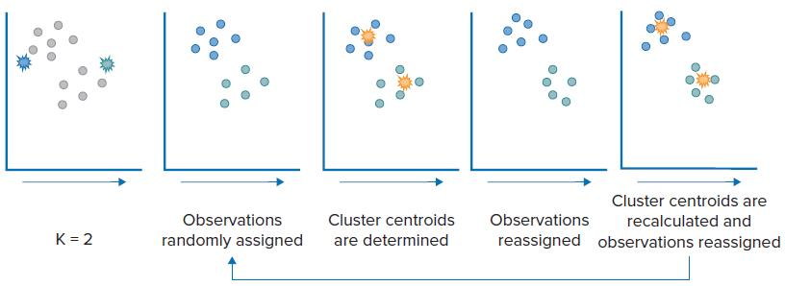
What Are the Types of Cluster Analysis? K-Means Clustering
K-means clustering uses the average data point in the cluster and minimizes the distance to individual observations.
Results are examined with the best number of different homogenous groups chosen, based on what leads to the most effective strategy.
An overall group mean is calculated, and observations are assigned to the group they are closest to in terms of their characteristics.
[2] Essentials of Marketing Analytics 1st Edition, By Joseph Hair and Dana E. Harrison and Haya Ajjan. Mc Graw-Hill (2022). ISBN10: 1264263600 | ISBN13: 9781264263608
Notes:
The graphic consists of five small panels showing the steps in the k-means process. In the first panel, k=2, so there are now 2 subgroups.
In the second panel, observations are randomly assigned to one of the two subgroups.
In the third panel, cluster centroids are determined.
In the fourth panel, observations are reassigned according to the identified centroids.
In the last panel, cluster centroids are recalculated and observations are reassigned.
The process loops back to re-determine cluster centroids again and again causing the clustering process to evolve.

Slide 7
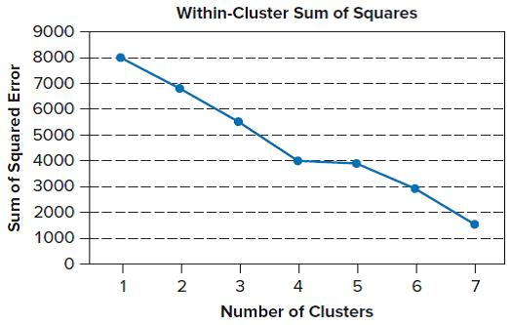
Cluster Evaluation – Elbow Chart
The analyst uses a line chart to evaluate the reduction in cluster error.
[2] Essentials of Marketing Analytics 1st Edition, By Joseph Hair and Dana E. Harrison and Haya Ajjan. Mc Graw-Hill (2022). ISBN10: 1264263600 | ISBN13: 9781264263608
Notes:
The elbow chart is a line graph depicting the within-cluster sum of squares.
The y-axis is the sum of squared error and rises in thousand increments from zero at the origin to 9,000 at the top.
The x-axis depicts the number of clusters ranging from one to seven.
The line consists of seven points and declines overall. The line starts at one cluster with the sum of squared error falling at 8,000. The second point, at two clusters, shows the error falls to just below 7,000. The third point, at three clusters, falls between 5,000 and 6,000. The fourth point, at four clusters, corresponds to 4,000 on the error axis and the fifth point, with five clusters, falls only slightly below this level corresponding in a plateau of the line. At six clusters, the line again begins to fall to 3,000 and the final point, at seven clusters, finds the line ending at between 1,000 and 2,000.

Slide 8
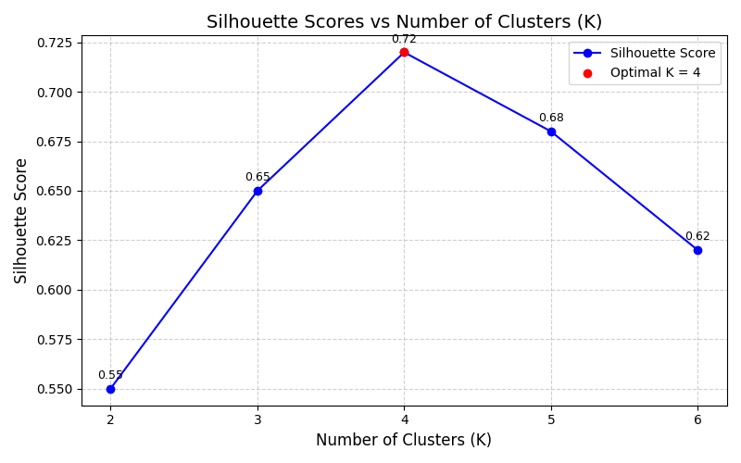
Cluster Evaluation – Silhouette Score
The silhouette score is calculated after the cluster algorithm has assigned each observation to a cluster.
Here, you determine the average distance between each observation in the cluster and the cluster centroid.
[2] Essentials of Marketing Analytics 1st Edition, By Joseph Hair and Dana E. Harrison and Haya Ajjan. Mc Graw-Hill (2022). ISBN10: 1264263600 | ISBN13: 9781264263608
Notes:
This line graph depicts the silhouette score on the y-axis and the number of clusters on the x-axis.
The y-axis starts at 0.30 and progresses in 0.02 increments to end at 0.44. The x-axis ranges from one to seven and the line has seven points.
The line begins at the first point, with one cluster, at a silhouette score of 0.42 and falls to 0.40 for point two at two clusters. The line drops sharply to 0.34 for three clusters and then falls a bit further to plateau at four clusters at slightly above the 0.30 silhouette score. The line remains roughly at the same location for points five and six, then climbs to a bit over 0.32 for point seven, at seven clusters.

Slide 9
K-Means Issues to Remember
To obtain the most accurate results, begin with data that has been standardized using z-scores or min-max.
K-means clustering can only be applied to numerical data.
[2] Essentials of Marketing Analytics 1st Edition, By Joseph Hair and Dana E. Harrison and Haya Ajjan. Mc Graw-Hill (2022). ISBN10: 1264263600 | ISBN13: 9781264263608

Slide 10
What Are the Types of Cluster Analysis? Hierarchical Clustering
A second widely used method for identifying subgroups for market segmentation is hierarchical clustering.
Individual observations are combined into subgroups using a measure of distance between observations.
There are two commonly used approaches.
With agglomerative clustering (a bottom-up approach), each observation is initially considered to be a separate cluster.
100 observations = 100 clusters.
With divisive clustering (a top-down approach), all records are initially assigned to a single cluster.
100 observations = 1 cluster
[2] Essentials of Marketing Analytics 1st Edition, By Joseph Hair and Dana E. Harrison and Haya Ajjan. Mc Graw-Hill (2022). ISBN10: 1264263600 | ISBN13: 9781264263608

Slide 11
Measuring Similarity with Hierarchical Clustering
Euclidean method.
The distance is measured as the true straight line distance between two points.
Manhattan method.
The distance between two points is not straight, but rather a path with right turns as if walking on a city grid.
Matching method.
Measures the similarity between two observations with values that represent the minimum differences between two points.
Jaccard’s.
Measures the similarity between two observations based on how dissimilar two observations are from each other.
[2] Essentials of Marketing Analytics 1st Edition, By Joseph Hair and Dana E. Harrison and Haya Ajjan. Mc Graw-Hill (2022). ISBN10: 1264263600 | ISBN13: 9781264263608

Slide 12
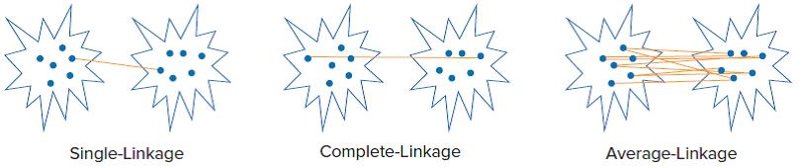
Measuring Similarity – Linkage Criterion
To measure similarity (dissimilarity), a linkage criterion can be used to capture the distance between the resulting clusters.
With complete linkage, similarity is defined by the maximum distance between observations in two different clusters.
With single linkage, similarity is defined by the shortest distance from an object in a cluster to an object from another cluster.
With average linkage, similarity is defined by the group average of observations from one cluster to all observations from another cluster.
[2] Essentials of Marketing Analytics 1st Edition, By Joseph Hair and Dana E. Harrison and Haya Ajjan. Mc Graw-Hill (2022). ISBN10: 1264263600 | ISBN13: 9781264263608
Notes:
Linkage criterion is depicted using three graphics, one for single-linkage, one for complete linkage, and one for average linkage.
For single-linkage, the two closest points of data are linked. Similarity is defined as the shortest distance from an object in one cluster to an object in another cluster.
In the middle graphic, complete-linkage is depicted. Here, the two points of data which are the farthest apart are linked, defining similarity.
In the final graphic, average-linkage is depicted. Here, each point is linked to points of data in another group and the average distance defines similarity.

Slide 13
Hierarchical Clustering – Ward’s Method
Another method of measuring distances with hierarchical clustering is Ward’s method.
Ward’s method applies a measure of the sum of squares within the clusters summed over all variables.
This method selects two clusters to combine based on:
Which combination of clusters minimizes the within cluster sum of squares for all clusters across all of the separate clusters.
[2] Essentials of Marketing Analytics 1st Edition, By Joseph Hair and Dana E. Harrison and Haya Ajjan. Mc Graw-Hill (2022). ISBN10: 1264263600 | ISBN13: 9781264263608

Slide 14
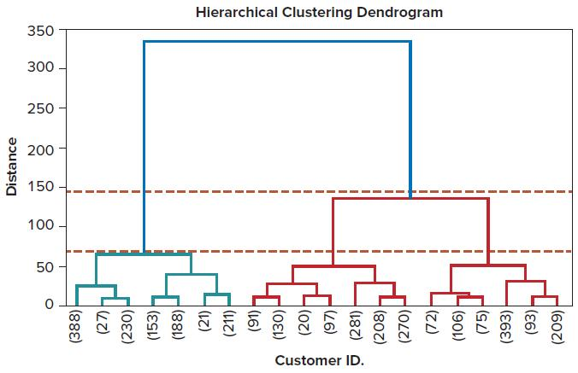
Exhibit 8-9: Hierarchical Clustering Dendrogram
All four measurement approaches can be illustrated with a dendrogram.
Identifying the correct number of clusters using a dendrogram is subjective.
[2] Essentials of Marketing Analytics 1st Edition, By Joseph Hair and Dana E. Harrison and Haya Ajjan. Mc Graw-Hill (2022). ISBN10: 1264263600 | ISBN13: 9781264263608
Notes:
The dendrogram depicts distance on the y-axis, advancing in increments of fifty, from zero at the origin to three hundred fifty at the top of the axis. The x-axis consists of individual customer ID numbers.
The illustration shows two main branches of a treelike graph, each dropping down from near the top at just under 350.
The branch on the left has a longer vertical line connecting to another branch just above the distance of 50. This branch again consists of two branches with the one on the left having two branches – one ends in customer ID 388 and the other branch ends in two branches which are customer IDs 27 and 230. The branch on the right again has two branches, each ending in two branches – one each for customer IDs 153, 188, 21, and 211.
Returning to the main branch and following the branch on the right, the dropping vertical line ends in a branch just below the distance of 150 and each branch has two branches which split at the distance of fifty. The twp branches on the left each end in two branches depicting customer IDs 91, 130, 20, and 97. The right branch ends in three points – customer IDs 281, 208, and 270. The final branch in the graph (the right branch on the right branch) has two branches ending in six branches corresponding to customer IDs 72, 106, 75, 393, 93, and 209.
The dendrogram also contains two horizontal dotted lines falling at just below distance 150, nearly at the top of the first branch on the right. The other line falls at just above distance fifty, at the top of the first branch on the left.

Slide 15
Hierarchical Clustering Issues to Remember
While k-means works only with numerical values, hierarchical clustering can be executed with a mixed set of data including both categorical and numerical values.
Also, similar to k-means clustering, the hierarchical clustering process should be executed with standardized data developed using either z-scores or min-max.
[2] Essentials of Marketing Analytics 1st Edition, By Joseph Hair and Dana E. Harrison and Haya Ajjan. Mc Graw-Hill (2022). ISBN10: 1264263600 | ISBN13: 9781264263608

Slide 16
Case Study – Online Perfume and Cosmetic Sales: Understanding Customer Segmentation through Cluster Analysis
The online perfume and cosmetic industry includes retailers who also sell products in brick-and-mortar stores, but patterns have shifted to online.
Industry revenue exceeds $16.2 billion annually and expected to grow.
The Chief Marketing Officer wants to understand customer behavior.
The goal is to segment the market to more effectively engage customers in marketing campaigns.
After downloading the dataset, you explore the data using Python.
The text guides you through 34 steps resulting in four clusters.
The analysis revealed four customer segments that can be targeted differently.
The retailer can use this knowledge to engage customers through targeted outreach programs and grow revenue through customer retention.
[2] Essentials of Marketing Analytics 1st Edition, By Joseph Hair and Dana E. Harrison and Haya Ajjan. Mc Graw-Hill (2022). ISBN10: 1264263600 | ISBN13: 9781264263608

Slide 17
Thank you
Question?

